Slide 1

Linear Algebra for Machine Learning: Introduction to Linear Algebra
Mina Farmanbar
Associate Professor, University of Stavanger
for engineers

Slide 2
A bird’s-eye view of basic ideas from linear algebra that appear in the context of machine learning
Introductory level
Never taken linear Algebra? Or know a little bit about the basics??
Want to get a feel for how they are used in Machine Learning?

Slide 3
Then this module is for you…
Non-technical
This module won't be a technical deep dive
We won't do a lot of computations or calculations or proofs of theorems
Primary Goal
Hope to whet your appetite to learn more!

Slide 4
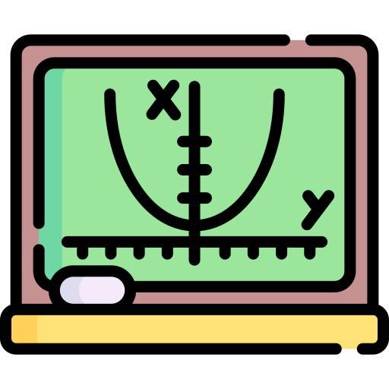



What’s on the menu for this module?
Linear Algebra
Data Representation
Vector Embedding
Dimensionality Reduction

Slide 5




Linear algebra is to machine learning as flour to bakery
Linear algebra is to machine learning as flour to bakery.
Every machine learning model is built on linear algebra, as every cake is built on flour.
But, of course, it's not the only ingredient!
Applied machine learning, like bakery, is essentially about combining these mathematical ingredients in clever ways to create useful (tasty?) models.
AI generated, Midjourney

Slide 6
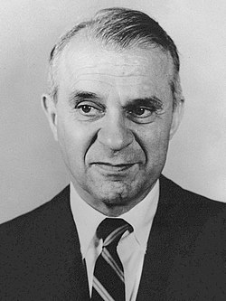
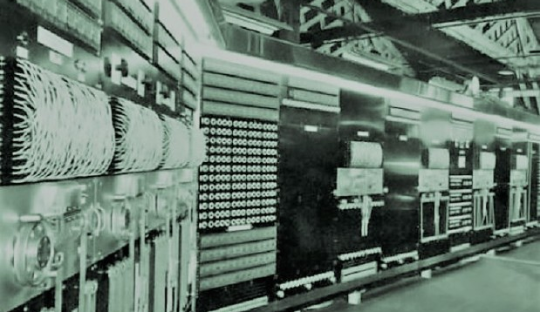
Back in 1949…
To check out and understand the U.S. economy, which is like studying how all the money and stuff is moving around in the country.
https://no.wikipedia.org/wiki/Wassily_Leontief
https://dirkdeklein.net/tag/harvard-mark-ii/
Wassily Leontief
Mark II computer

Slide 7
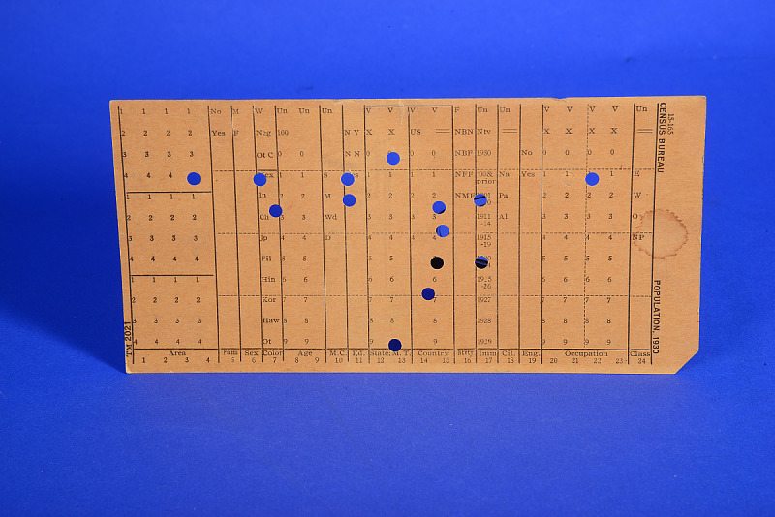
Special math model
These cards had:
details from over 250,000 pieces of data
were collected for two whole years!
With all this data, Leontief created a special math model to break down the U.S. economy into 500 sections
Each of these sections had a math equation to show how they shared their goods and services with the other sections.
The only problem was that the Mark II computer was a bit old school and couldn't handle all 500 equations at once.
So, Leontief simplified things into 42 equations, which made it easier for the computer to handle.
https://americanhistory.si.edu/collections/object-groups/punch-cards/punch-cards-data-processing
Punched card sample filled with information from the U.S. Bureau of Labor Statistics

Slide 8
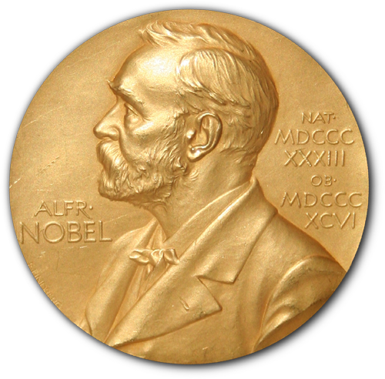
Now, here's the exciting part:
It took the Mark II computer 56 hours (that's more than two days!) to figure out the solution to the math problem.
This was a big deal because it was one of the first times a computer was used to understand such a huge mathematical model in economics.
https://en.wikipedia.org/wiki/Nobel_Prize
Nobel Prize in Economic Science in 1973

Slide 9
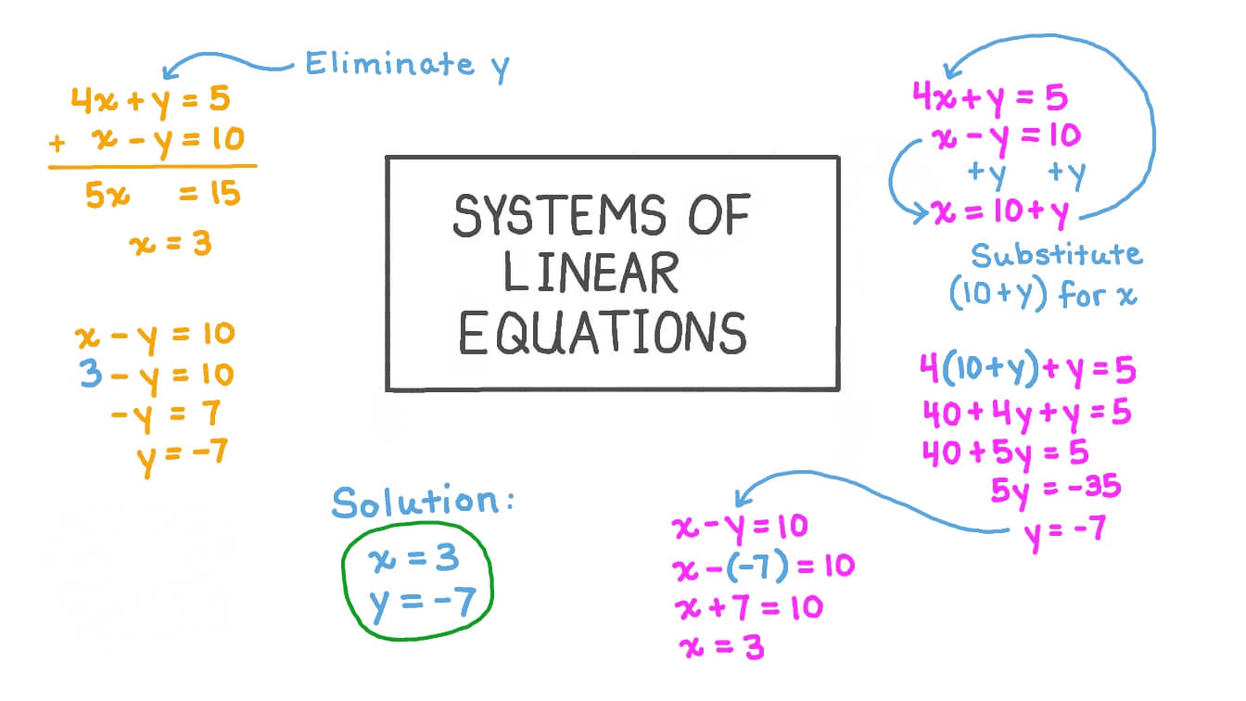
Since then…
These models often deal with a ton of data and are usually linear, meaning they involve systems of linear equations – basically, a bunch of connected straight lines.
https://www.nagwa.com/en/videos/537137236176/
Scientists in different fields have been using computers to explore and understand mathematical models.

Slide 10
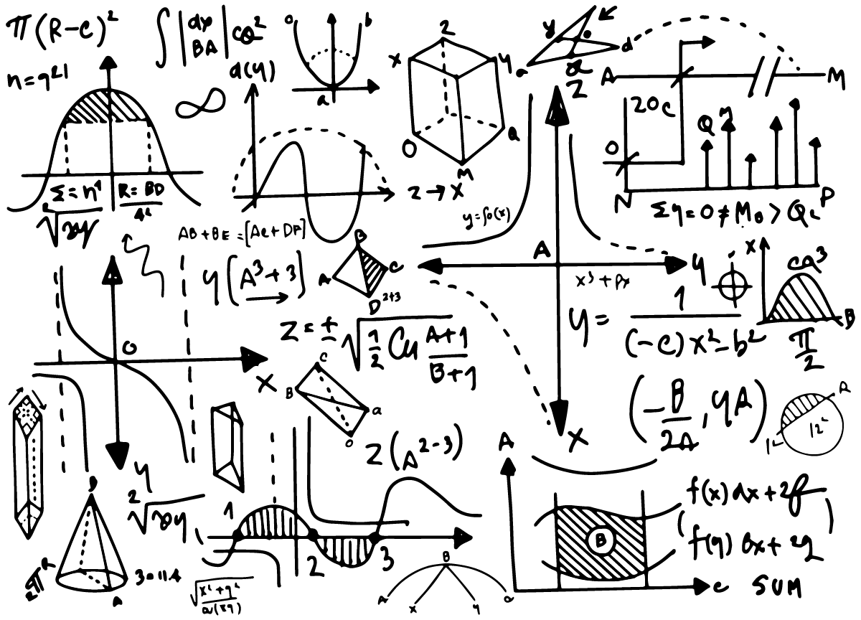
Linear Algebra
As computers get more powerful, the importance of a subject called linear algebra keeps growing…
https://guzintamath.com/textsavvy/2019/03/23/linear-algebra-exercises-i/

Slide 11
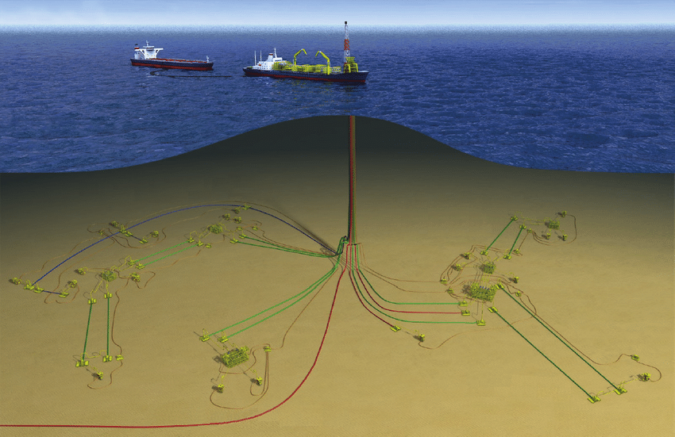
Oil Exploration
A ship in the ocean hunts for oil using supercomputer detectives. They crack thousands of equations daily, guided by seismic maps made by underwater shock waves.
These waves, caused by air gun blasts, bounce off rocks and are detected by geophones.
https://www.researchgate.net/figure/Example-of-offshore-oil-and-gas-production-systems-and-nomenclature-nomenclature_fig1_283068304

Slide 12

Linear Programming
Ever wonder how airlines plan their flights, manage their crews, and keep track of aircraft?
Linear programming is the superhero behind these decisions.
This mathematical approach uses hundreds of variables to create models that help airlines schedule flight crews, monitor planes, and organize support services like maintenance and terminal operations.
https://blog.klm.com/flight-plan-in-10-steps/

Slide 13
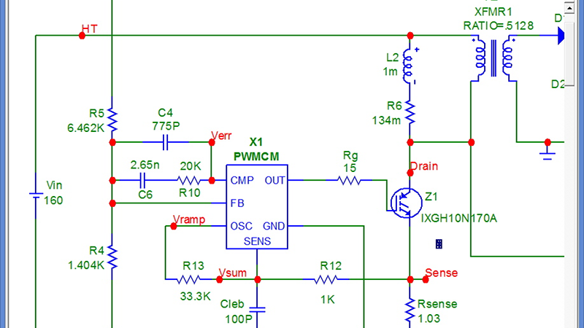
Electrical Networks
Engineers working on designing electrical circuits and microchips use powerful simulation software. These circuits can involve millions of tiny transistors!
The software relies on linear algebra techniques and systems of linear equations to make sure everything works seamlessly.
It's like creating a digital orchestra where each tiny part plays its role perfectly to produce amazing electronic symphonies.
https://hackaday.com/2020/01/08/commercial-circuit-simulator-goes-free/

Slide 14
Linear algebra is…
Linear Algebra is the secret key factor that makes it all possible.
It's like having a superpower that lets us solve big, complex problems in the real world.
…and these are just a few examples – there's a whole world of possibilities out there waiting for you to explore with the help of linear algebra!

Slide 15
Summary
This module provides an introductory level overview of linear algebra for applied machine learning.
These lectures are based in a series of (mostly) freely available textbooks, video lectures, and classes I’ve read, watched and taken in the past.
If you want to obtain a deeper understanding or to find exercises for each topic, you may want to consult those sources directly.

Slide 16
Thank you!
Mina Farmanbar
mina.farmanbar@uis.no

